Slide 2
The Early Career Framework
Evidence based development programme for ECTs. Our provider is Teach First and their programme focuses on 12 core areas over 2 years.
Delivered by various methods – Induction Day, self directed online study sessions and face to face seminars (12 in Year 1 and 6 in Year 2)
Supported by structured weekly mentoring sessions (Year 1) fortnightly in Year 2
By completing the ECF programme with Teach First, the ECT is accessing a nationally recognised programme that meets the DfE’s fidelity requirements for their inductions.

Slide 3
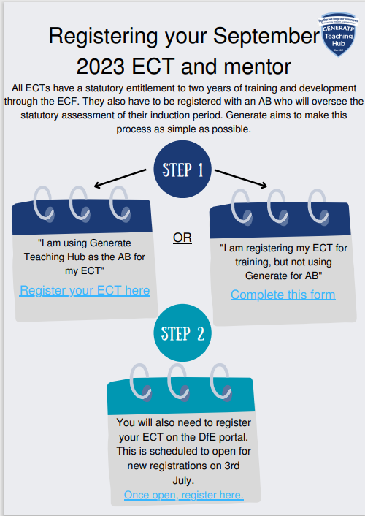

Slide 6
Get in touch…
hub@wpat.uk

